Slide 1

SWE-4739: Embedded Software Development
Credit: 3.00
Lec-1: Introduction to Embedded Software
Thanks to: Md. Nazmul Haque
Creating Global Citizens Rooted with Islamic Values

Slide 2

Definition
System: It is an arrangement in which all its units are assembled, work together according to a set of rules. E.g.- Watch is a time displaying system.
Creating Global Citizens Rooted with Islamic Values
2

Slide 3
Definitions
Embedded system can be defined as either of the following
Has computer hardware with software embedded in it as one of its components
A microprocessor based system that does not look like a computer
A combination of computer hardware and software, and perhaps additional mechanical or other parts, designed to perform a specific function.
Creating Global Citizens Rooted with Islamic Values

Slide 4
Definition
Embedded System is a
Combination of hardware and software
Designed to perform a specific task
Need to be completed in a given time
Example: Washing Machine, Micro oven and so on.
Creating Global Citizens Rooted with Islamic Values

Slide 5
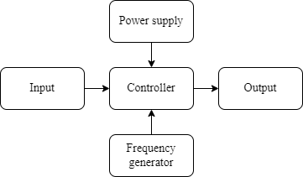
Building blocks of Embedded System
Input: sensors, buttons, touch panels, Bluetooth, Infrared Rays (IR)
Output: LEDs, LCDs, Bluetooth
Controller: ROM, RAM, ALU, Control Unit (CU)
Frequency generator: crystal oscillator
Creating Global Citizens Rooted with Islamic Values

Slide 6
Some applications of Embedded System
Medical System
Pacemaker
Patient monitoring system
Office equipment
Printer
Fax machine
Tools
GPS
Multimeter
Banking
ATM
Statement printer machine
Creating Global Citizens Rooted with Islamic Values

Slide 7
Embedded vs Desktop Software
Memory size
CPU power
Code optimization
Operating system
Real time behavior
Development paradigm
Execution paradigm
Every Embedded system is different
Creating Global Citizens Rooted with Islamic Values

Slide 8
Characteristics of Embedded System
Sophisticated functionality
Real time operation: completed within the deadline
Low manufacturing cost
Low power consumption
Application dependent processor
Restricted memory
Creating Global Citizens Rooted with Islamic Values

Slide 9
Embedded Software Tools and Components
Development tools
Code modules are compiled
Linked together along with libraries of reusable components
executed under the control of a debugger
In addition: profilers: show how real time is being utilized,
power analyzer: track how device power consumption relates to code execution
Software components
Libraries
OS
Networking
Hard drives (rarely use)
Creating Global Citizens Rooted with Islamic Values

Slide 10
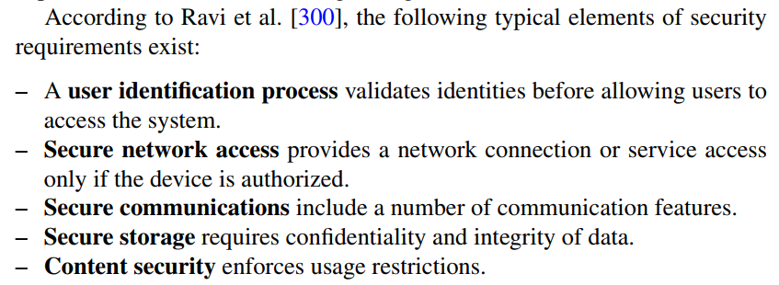
Challenges
1. Security:
This preservation can be compromised by thefts or damages, resulting from attacks from the outside.
Connecting more components enables more attacks and more damages.

Slide 11
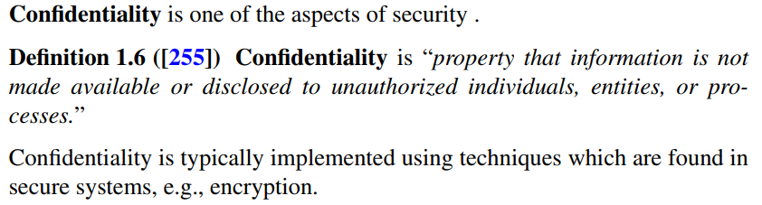
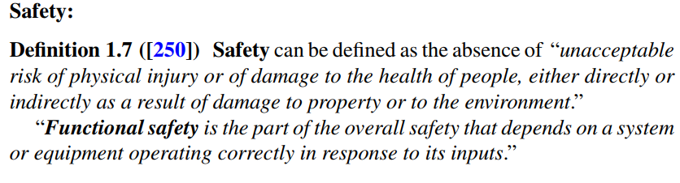
Challenges
2.
3.

Slide 12
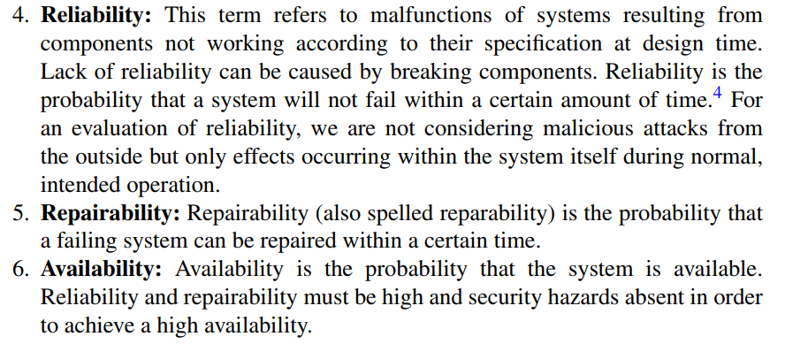
Challenges

Slide 13
Challenges
7. Real Time Constraints:
Many cyber-physical systems must meet real-time constraints. Not completing computations within a given time frame can result in a serious loss of the quality provided by the system (e.g., if the audio or video quality is affected) or may cause harm to the user (e.g., if cars, trains, or airplanes do not operate in the predicted way)

Slide 14
Challenges
8. Hardware-Software Co-Design
Designing only hardware or software is not enough, no matter how good they are. It is necessary to keep both in mind, together, when designing due to the requirement of effective and efficient system.

Slide 15
Challenges
9. Efficient Resource Utilization:
Energy
Run-time
Code
Weight
Cost

Slide 16
Challenges
10. Impact beyond technical issues: Due to the major impact on society, legal, economic, social, human, and environmental impacts must be considered as well.
Furthermore, real embedded systems consist of many components and we are interested in compositional design. This means, we would like to study the impact of combining components. For example, we would like to know whether we could add a GPS system to the sources of information in a car without overloading the communication bus.

